Slide 1
Predicting Current Laptop Prices
Kyle Brinker

Slide 2

Goal
Predict the latest price for a laptop based on the computer hardware and specifications.

Slide 3
Data Overview
The data involves 896 Observations along with 23 predictor variables.
Contains data on laptop prices (Indian Rupees) along with
Component Specifications
Storage, Weight, Touchscreen Capabilities, Brand, Processor, etc.
Warranty Information
Discount
Old Price

Slide 4
Preliminary Feature Selection
Removed the model type because the model will be associated with the brand of a laptop.
In addition, the brand has less unique values, which will help with the data analysis process. The processor name was also removed for similar reasons as the name would be associated with the brand of processor.
The discount was also removed since we are looking to predict the latest price; therefore, if we have the discount, then we are no longer predicting the latest price.
The ratings will also be removed as it has a high correlation with the number of reviews, suggesting they might be multicollinearity.

Slide 5
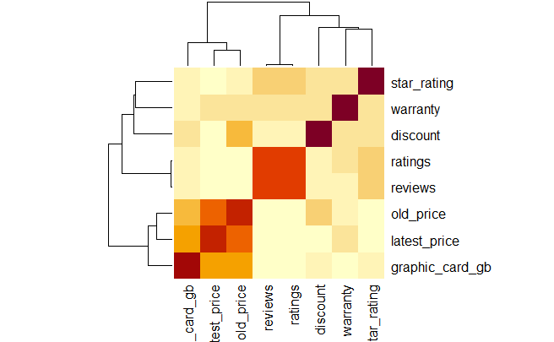
Heatmap of Numeric Predictors

Slide 6
Stepwise Selection
The model was selected based on the lowest AIC score of 10586.22.
The resulting model was based on forward-backward selection.

Slide 7
Stepwise Selection Continued
Predictors Included:
Graphics Card Gigabyte
Warranty
Old Price
Brand
Apple, Alienware, Smartron, HP, or ASUS
Number of Stars
Ratings
No touchscreen
Processor
AMD, Intel, or M1
Processor Generation
4^{th,} 7^{th,} 8^{th,} 10^{th,}12th
Ram
4 GB, 8 GB, or 16 GB
Ram Type
LPDDR4 or LPDDR3
SSD
0 GB, 128 GB, 256 GB, 512 GB, 1 TB, 2 TB
HDD
0 GB, 512 GB
DOS OS
Screen Size
13.3”, 13.4”, 14”, 14.1”, 14.2”, 15.6”, 16”, 16.2”
Weight (Gaming)

Slide 8
Model Conclusion
The model produced using stepwise regression suggests that the latest laptop price depends on:
Specific Brands
Screen Size
Original Price
Reviews
Storage (SSD & HDD)
Touchscreen Capability
Processor Type and Generation

Slide 9
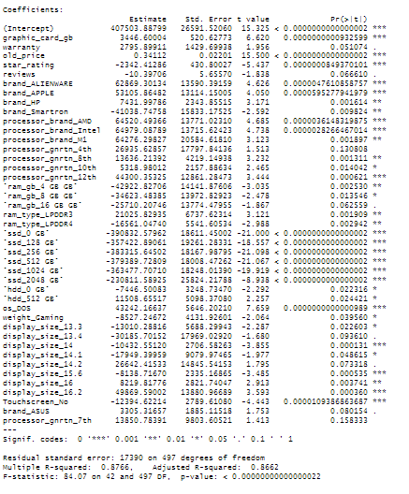
Coefficients

Slide 10


Accuracy Measures and Conclusion
Full Model:
Reduced Model
Based on the accuracy, the reduced model would be a better choice as it has less predictor variables and only a slightly higher RMSE, signifying a model with the relatively same accuracy, but less predictor variables.

Slide 11
Bibliography
Kumar, S. (2022, April 3). Laptop specs and latest price. Kaggle. https://www.kaggle.com/datasets/kuchhbhi/latest-laptop-price-list

